Slide 2
This is our billboard

Slide 3
This is our magazine ad

Slide 4
Magisto Movie
http://www.magisto.com/video/MlUNYQcWEDVuX0BgCzE?openshare

Slide 5
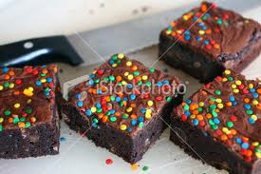
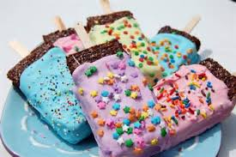
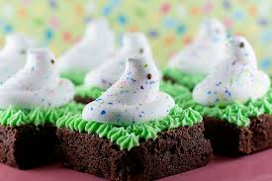
Thanks for watching!!!

